Slide 1
Mark-Sweep
A tracing garbage collection technique
Hagen Böhm
November 21st, 2001
hagen@net.uni-sb.de
Copyright, 1996 © Dale Carnegie & Associates, Inc.

Slide 2
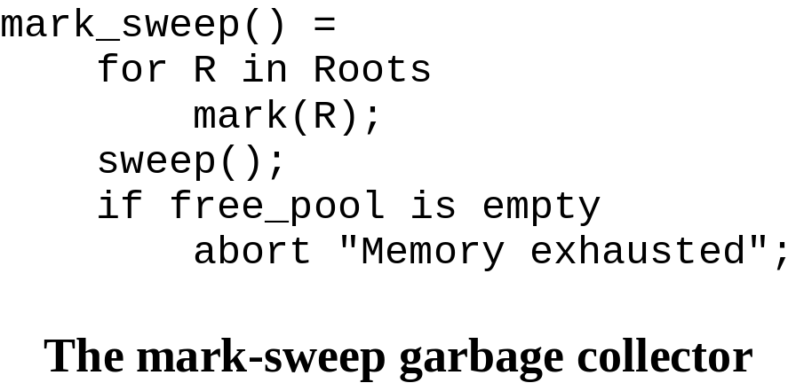
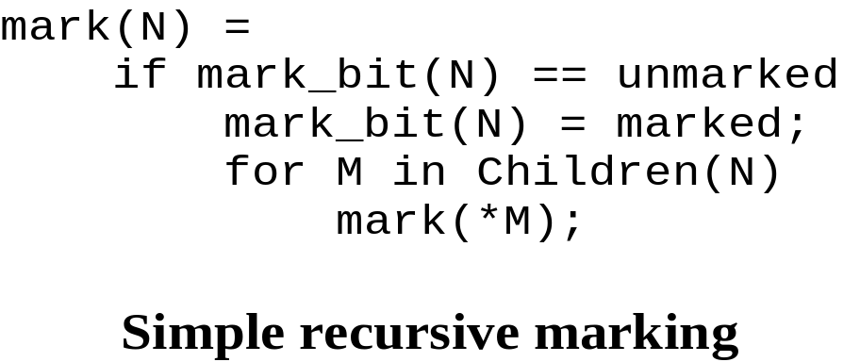
The basic mark-sweep algorithm
first algorithm for automatic storage reclamation (McCarthy 1960)
a stop and run algorithm
tracing garbage collection technique

Slide 3
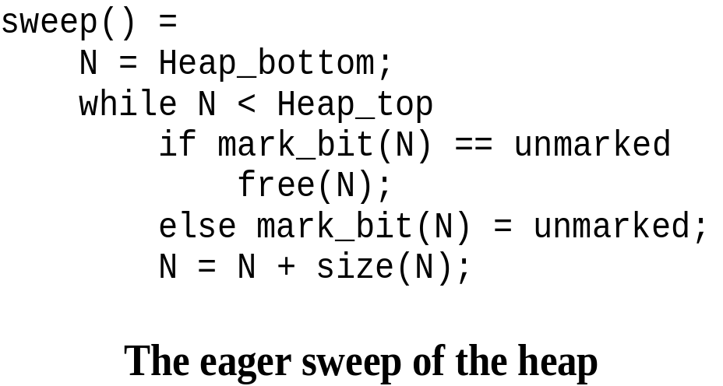
The basic mark-sweep algorithm
works in 2 Phases:
  mark all live nodes by global traversal
  sweep the heap by a linear scan

Slide 4
The basic mark-sweep algorithm
benefits
  handles cycles naturally
  no overhead on pointer manipulations
  low space cost: using a simple mark-bit (architecture depend!!!)

Slide 5
The basic mark-sweep algorithm
drawbacks
  computation halted while gc
  high costs!
    every active cell is visited by marking
    all cells are examined by sweep
    recursive marking (time and space!)
  tending to fragment memory => programs may “thrash”
  heap residency too large => gc will become high frequently

Slide 6
Outlook onto improvements
iterative solution to marking using a marking stack
  minimising the depth of the stack
  handling overflows
pointer reversal
bitmap marking
lazy sweeping

Slide 7
Iterative marking
Recursive procedure calls are time- and space-wasting
  reserving/discarding working space
  procedure call overheads
improve the performance by ...
  replacing recursive calls by iterative loops
  using an auxiliary stack for pointers to nodes known to be live.

Slide 8
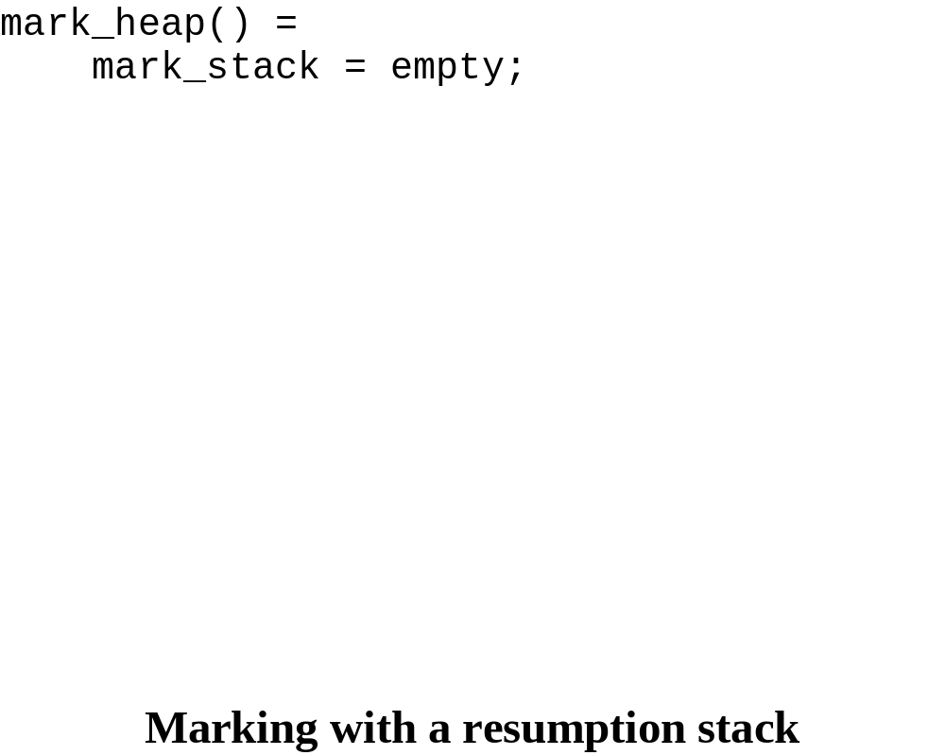
Iterative marking

Slide 9
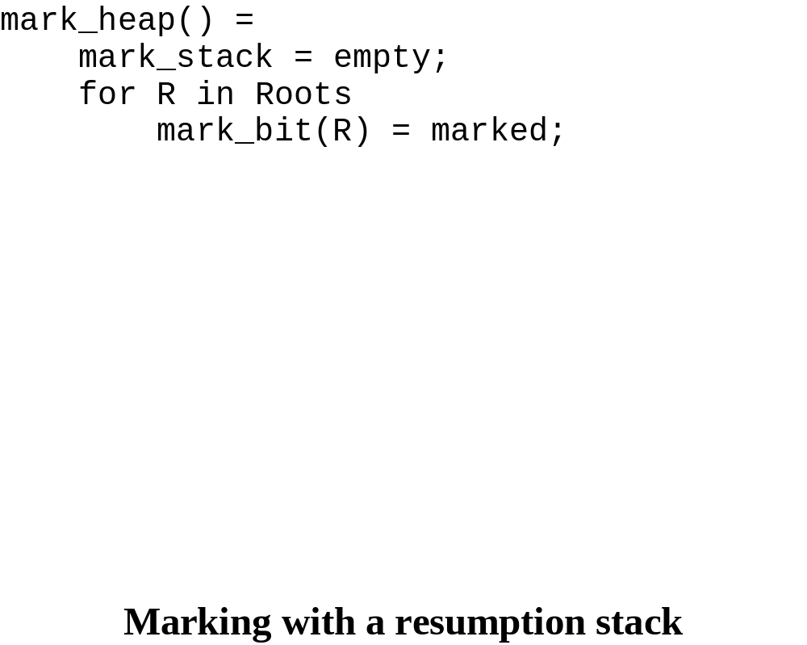
Iterative marking

Slide 10
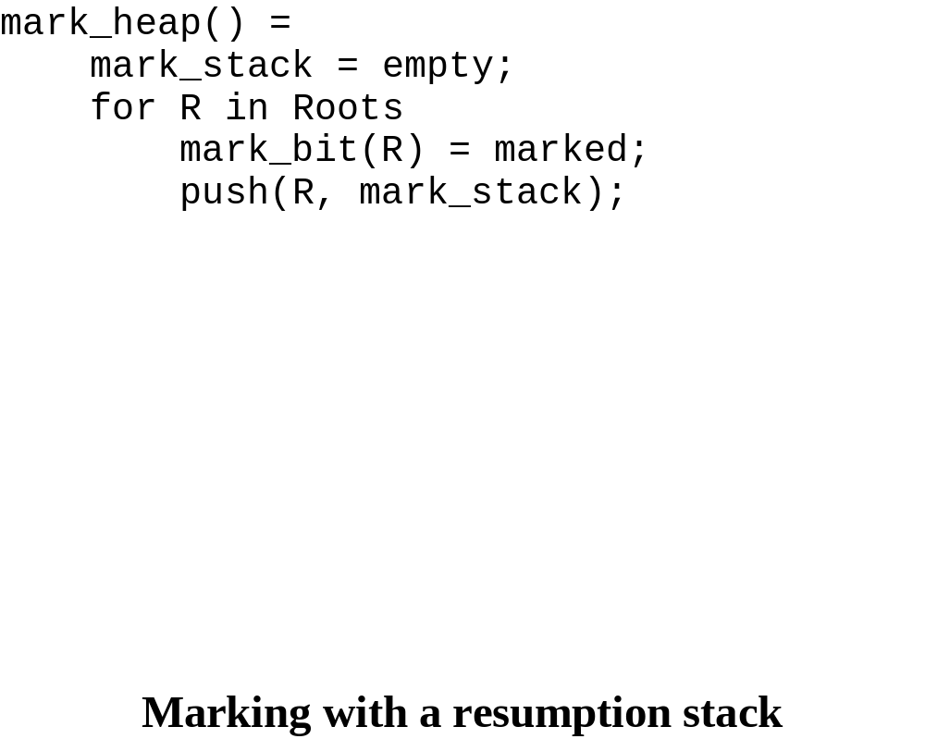
Iterative marking

Slide 11

Iterative marking

Slide 12
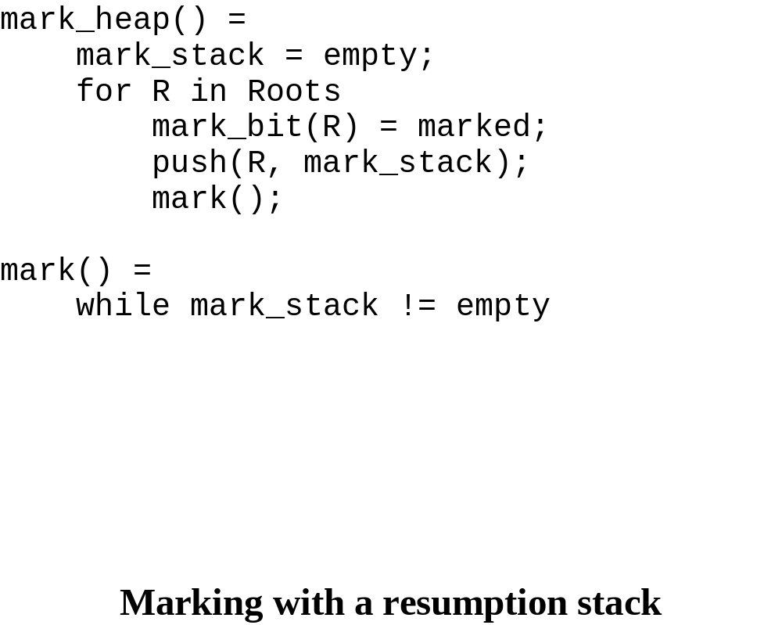
Iterative marking

Slide 13
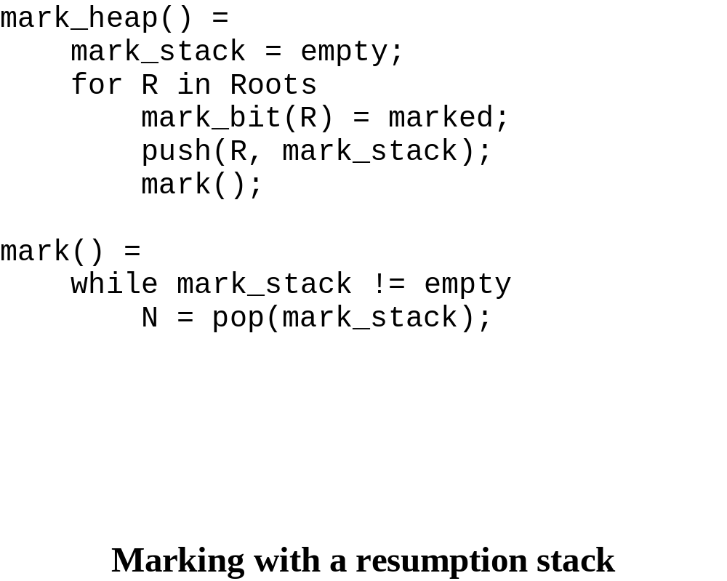
Iterative marking

Slide 14
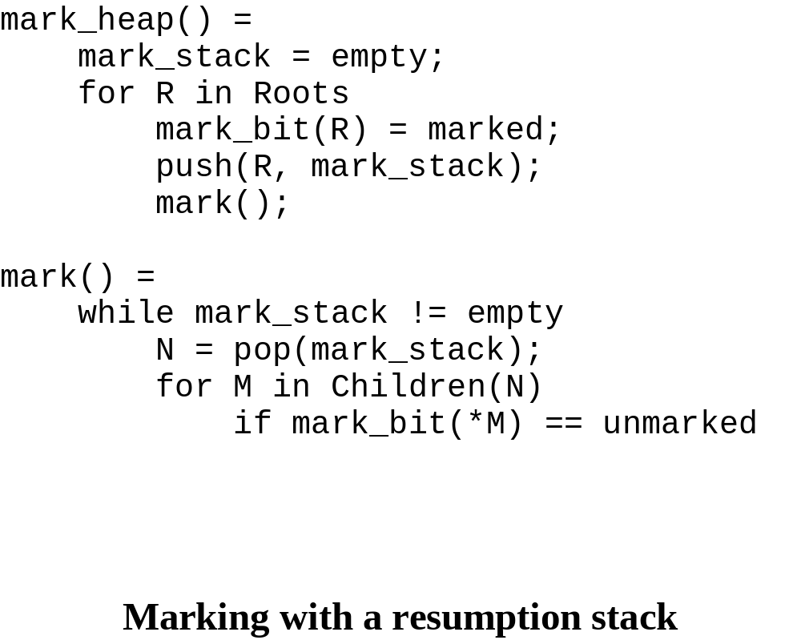
Iterative marking

Slide 15
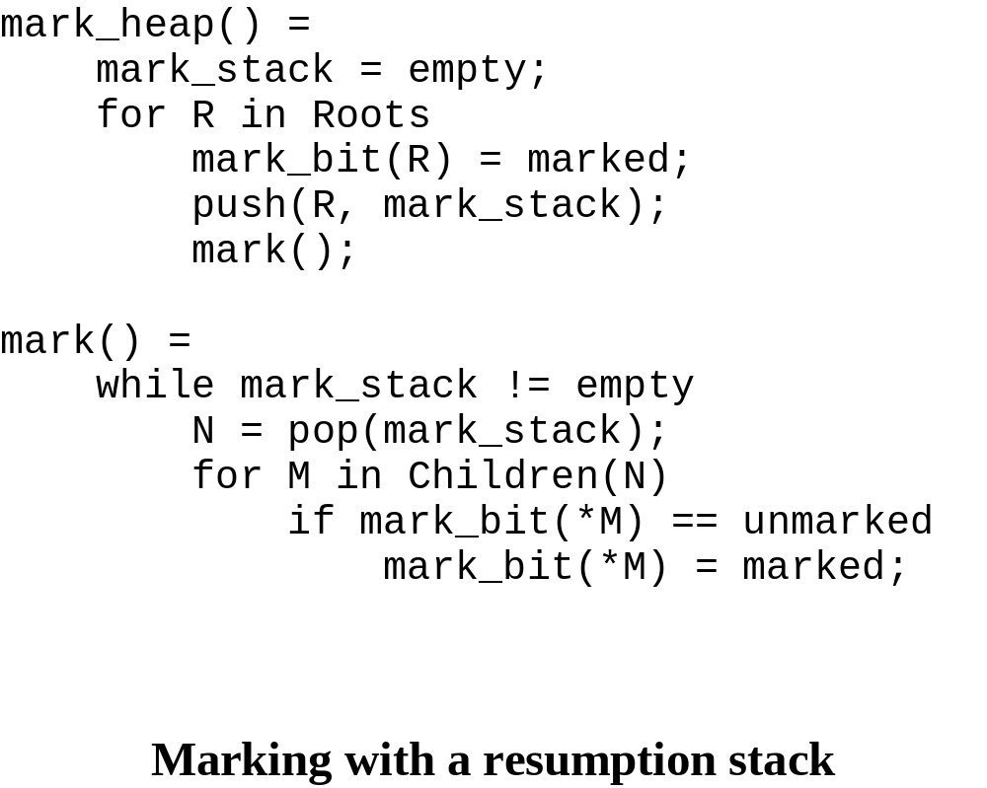
Iterative marking

Slide 16
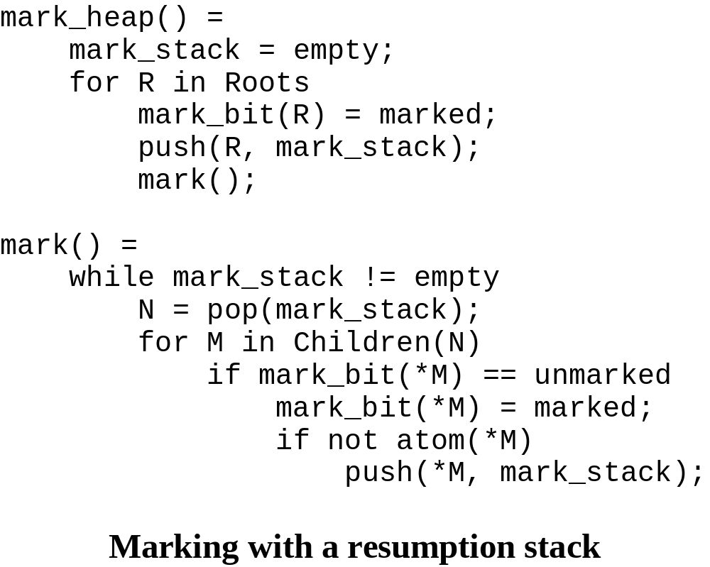
Iterative marking

Slide 17
Minimising stack depth
pushing constituent pointers of large objects in small groups onto the stack
using pointer reversal (more later)

Slide 18
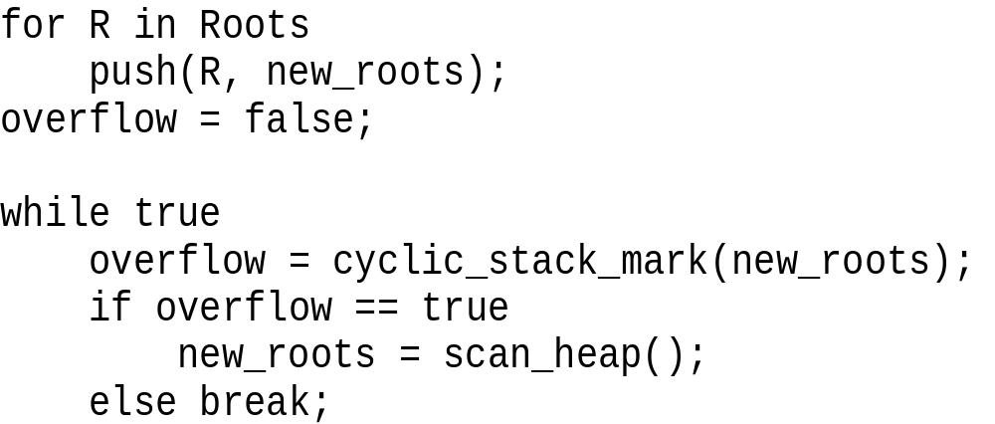
Handling Stack Overflow
Knuth proposal in 1973
  treating the marking stack circularly
  scan_heap returns marked nodes pointing to unmarked nodes

Slide 19
Handling Stack Overflow
Kurokawa proposal in 1981
  remove items from stack that have fewer than 2 unmarked children
    no child is unmarked: clear slot
    one child is unmarked: replace slot entry by a descendent with 2 or more unmarked children marking the passed ones
  approach is not robust!!!

Slide 20
Pointer reversal
efficient marking must record the trace it passed
temporarily reversing of pointers traversed by mark (child-pointers become ancestor-pointers)
restore pointer fields when tracing back
developed independently by Schorr and Waite (1967) and by Deutsch (1973)

Slide 21
Pointer reversal
head of
graph
DFA for binary tree structures
enter
advance
retreat
atom or
marked
unmarked
head of
sub-graph
internal node
of sub-graph
switch

Slide 22
Pointer reversal (advance phase)
previous
current

Slide 23
Pointer reversal (advance phase)
previous
current

Slide 24
Pointer reversal (advance phase)
previous
current
next

Slide 25
Pointer reversal (advance phase)
previous
current
next

Slide 26
Pointer reversal (advance phase)
previous
current
next

Slide 27
Pointer reversal (advance phase)
previous
current
next

Slide 28
Pointer reversal (switch phase)
previous
current
next

Slide 29
Pointer reversal (switch phase)
previous
current
next

Slide 30
Pointer reversal (switch phase)
next
previous
current

Slide 31
Pointer reversal (switch phase)
next
previous
current

Slide 32
Pointer reversal (switch phase)
next
previous
current

Slide 33
Pointer reversal (switch phase)
next
previous
current

Slide 34
Pointer reversal (retreat phase)
next
previous
current

Slide 35
Pointer reversal (retreat phase)
next
previous
current

Slide 36
Pointer reversal (retreat phase)
next
previous
current

Slide 37
Pointer reversal (retreat phase)
next
previous
current

Slide 38
Pointer reversal (retreat phase)
next
previous
current

Slide 39
Pointer reversal for variable-sized nodes
2 additional fields per node
  n-field: total number of pointer fields
  i-field:number of sub-trees fully marked
i > 0: node is marked
i == n: all children have been marked

Slide 40
Features of pointer reversal
requires constant space (only 3 pointers: current, previous, next)
hides the marking stack in heap nodes (overhead is shifted!!)
requires high time-cost:
  visits each branch-node at least (n+1) times
  each visit requires additional memory fetches
  each visit cycles 4 values + reading/writing mark-flags

Slide 41
Pointer reversal conclusion
Don’t use
pointer reversal!!!!
except for having problems with stack overflow...

Slide 42
Bitmap marking
Problem: where to find space for mark-bits in objects?
Solution: store them in a separate bitmap table

Slide 43
Features of bitmap marking
one bit start-address of object in heap
size of bitmap inversely proportional to size of smallest object
the bit corresponding to an object is accessed by shifting object’s address

Slide 44
Bitmap marking (example)
32-bit architecture
smallest object = 2 words
bitmap takes about 1.5 % of heap.
if p is start address of object, then mark-bit
is accessed by:
mark_bit(p) =
return bitmap[p>>3];

Slide 45
Bitmap marking pro/contra
benefits
  requires small space
  bitmap mostly can held in RAM
  heap mustn’t be contiguous
  mark-bits can be saved due to large objects
  big atomic objects never be touched
  in sweep no object need to be accessed
drawbacks
  access bitmap more expensive than writing to object

Slide 46
Lazy sweeping
Problem: sweep phase expensive!!!
But:
  pre-fetching pages or cache lines will be profitable
  much less likely to effect virtual memory behaviour

Slide 47
Lazy sweeping
Problem: sweep interrupts user program!!!
Improvement: execute sweep in parallel with mutator

Slide 48
Hughes’s lazy sweeping [1982]
do a fixed amount of sweeping at each allocation
sweep-phase cost transferred to allocation
no free-list manipulations
bitmaps reduce performance!!!

Slide 49
Boehm-Demers-Weiser sweeper [first in 1988]
2-level allocation:
  low-level: acquire blocks from OS for single sized objects
  high-level: assign objects to the blocks
free-list for each object size, threaded through blocks
queues for reclaimable blocks

Slide 50
Block header
one header per block held on linked-list containing additional info
hb_sz
Size of objects in block
hb_next
block header to be reclaimed
hb_descr
hb_map
hb_obj_kind
(atomic, normal)
hb_flags
hb_last_reclaimed
hb_marks
mark bits

Slide 51
Zorn’s lazy sweeper [1989]
for each object size => cache vector of n objects
Vector empty? Sweep to refill it!
sweeping = allocating (10-12 cycles)

Slide 52
MS? RC? CC?
Tracing gc = much lower overhead on mutator than RC
considering caching/virtual memory environment, answer gets more difficult (MS or CC???)
depends on application!

Slide 53
Space and locality
mark-sweep...
  require less address space
  has better cache and vm behavior
  bitmap improvement (only reading live, non-atomic objects in mark-phase)
  adding object to free-list may cause page fault/cache miss

Slide 54
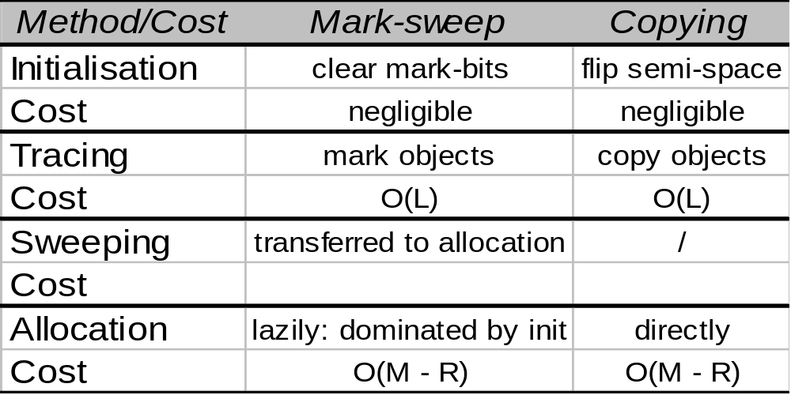
Time complexity
L = volume live data in heap
R = residency user program
M = heap size
Amortized cost are the same, constants not!
Object size is important!
Copying collector better to implement :-(

